Slide 1
Performance Evaluation System
Part II: New Reporting Officials

Slide 2
Agenda
System Overview
Marking Philosophy
Writing to a Profile
RS vs RO role
Writing Effective Comments
Counseling Responsibilities
Record Corrections

Slide 3
USMC Fitness Report (FITREP) Overview
Guiding Document is MCO 1610.7 (Performance Evaluation System)
Consist of five pages
Grades Marines across 13 separate areas, which are called “Attributes”
14 areas if the Marine being Reported On (MRO) is a reporting official (meaning he/she writes fitness reports)
Attribute grades, which are called “Performance Anchored Ratings (PARS)”, range from A-H
FITREP’s are completed by two reporting officials:
Reporting Senior (RS): Normally the first officer in the MRO’s chain of command
Reviewing Officer (RO): Normally the RS’ RS

Slide 4
Normal FITREP Routing Process
Notes:
MRO = Marine the FITREP is being written on
RS = the first commissioned or warrant officer (or civilian GS-9/equivalent or above) in the reporting chain senior to the MRO
RO = is the first commissioned or warrant officer (or civilian GS-10/equivalent or above) senior in grade to the RS and the officer directly responsible for the primary tasking, supervision, and evaluation of the RS

Slide 5
RS Profiles
Assigned PAR’s are used to calculate the FITREP average (FITREP Avg)
FITREP Avg’s are tracked and form the RS’ profile
RS’ have to write at least three observed fitness reports on Marines of the same rank before they obtain a profile
All of the FITREP Avg’s within an RS’ profile are used to calculate the RS’ average FITREP Avg (RS Avg)
The fitness report with the highest FITREP Avg in an RS’ profile is the “RS High”
RS profile metrics and the FITREP Avg are used to assign the report a relative value (RV) number

Slide 6
Relative Value
RV is a metric used by Promotion/Selection/Retention boards to put FITREP marks into context
It is a time saving metric that prevents board members from having to pull the profile of every RS of every report for every Marine being considered by the board
RV does not serve any other purpose

Slide 7
FITREP Average
Process:
FITREP’s have14 attributes
Each attribute is given a letter grade from A-H, and each letter grade corresponds to a number:
A=1, B=2, C=3, D=4, E=5, F=6, G=7, and H=0
“H” attribute marks represent “not observed” attributes and are not used in the calculation of the “FITREP Average”
Sum of attributes/Number of observed attributes = FITREP Average
Example:
3 + 3 + 2 + 2 + 3 + 3 + 2 + 3 + 3 + 2 + 2 + 2 + 3 + 0 = 33
33/13 = 2.53 = FITREP Average

Slide 8
RS Average
Process:
The “FITREP Average” for all FITREP’s an RS has written on Marines of a certain grade are added up and then divided by the number of reports
Example:
3.3 + 3.23 + 3.23 = 9.76
9.76/3 = 3.26
The formula used by MMRP does not round the numbers up to two decimal places—which is why the math works out to 3.26 vice 3.25

Slide 9
RS High
Process:
There is no process. It is simply the highest “FITREP Average” an RS has given.
Example:
High = 3.3

Slide 10
Marking Philosophy

Slide 11
Marking Philosophy
What is a marking philosophy?
The weight a reporting senior assigns to the PAR’s for individual attributes
Similar to individual PFT event scores:
5 pull-ups = 40 points
6 pull-ups = 43 points
PAR assignment:
Established criteria for “Proficiency” for a Sgt = “B” PAR
Established criteria for “Proficiency” for a Sgt = “C” PAR
You assign the criteria, but you must keep the rationale standardized for all Marines of the same rank

Slide 12
PAR Criteria Requirements
Once you have established your marking philosophy you cannot change it
That would be similar to running a PFT, and then the PFT evaluator changing the event requirements for the next Marine
Criteria for Marines in different billets will not be exact, but the principle has to remain the same
The factors considered to determine a Sgt in an infantry billet and a Sgt in an administrative billet is above average at “Leading Subordinates” will be different, but the rationale for the grade will be the same
In this instance, your job is to break out the Marines ability to lead subordinates—regardless of their billets
Your job is not to break out the Marine who simply has more opportunities to lead subordinates

Slide 13
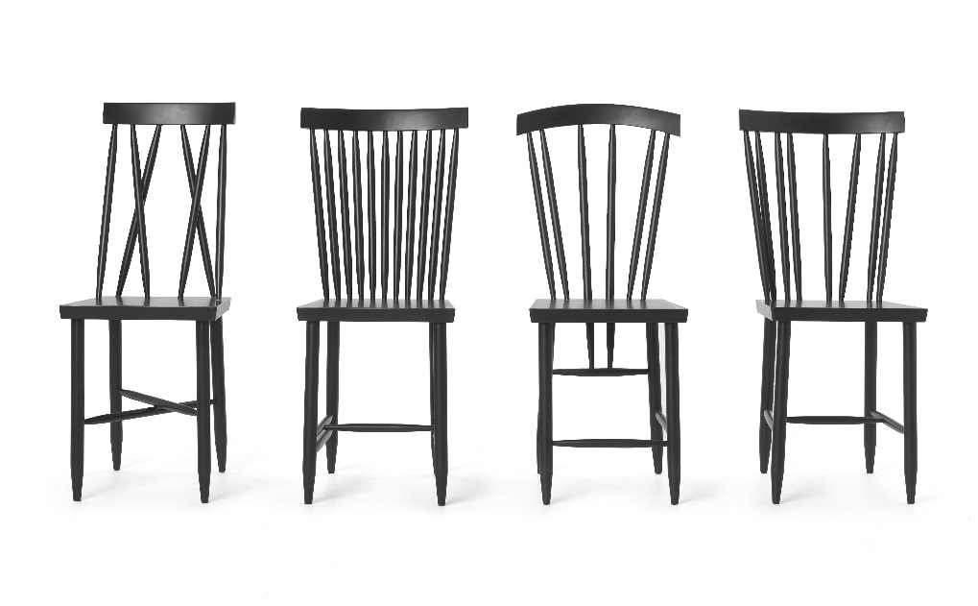
Marking Philosophy Demonstration
X
B
C
E
F
G
A
D
H

Slide 14
Marking Philosophy Construction
14 Attributes/4 Common PAR’s
Determine which letter grade represents an average mark for you? C?
Develop standardized criteria (expectations) for what rates a B/C/D/E/F/G—for EVERY attribute
Adapt your criteria for rank/MOS/billet, but do not change your marking philosophy

Slide 15
Establishing a Marking Philosophy
First—Read the PARS descriptors in Chapter 4 of the PES Order (MCO 1610.7)
Second—Talk to other reporting officials and senior enlisted Marines about expectations for individual attributes
Third—Familiarize yourself with what the Marines are/are not supposed to do
Fourth—Ask more questions

Slide 16
Benefits of using a Marking Philosophy
Fair
MRO understands your expectations and has ownership of their performance
Consistent
Your standard becomes more and more objective over time—increasing the effectiveness of your profile
Proper measuring stick
Promotion/selection/retention board decisions assume a known standard, not an undefined separate/individual standard

Slide 17
Writing to a Profile

Slide 18
The Other Method in Use
Writing to a profile
DO NOT let someone talk you into this method!
Reporting officials use it because they believe:
It is easier to understand
Less time consuming
Gives them the ability to directly influence a promotion/selection/retention board
Partially true at the start of your profile
Becomes impossible to manage as your profile develops
This method was used for the previous system and it drove it into extinction
Negates the design of the current system, thereby invalidating all of the numerical data

Slide 19
Ranking Marines
Unit PFT Results
Marine | Score | Rank
Sgt A | 228 | 4
Sgt B | 220 | 7
Sgt C | 225 | 5
Sgt D | 224 | 6
Sgt E | 298 | 1
Sgt F | 234 | 2
Sgt G | 189 | 8
Sgt H | 232 | 3
Ranking Results
Marine | Rank
Sgt E | 1
Sgt F | 2
Sgt H | 3
Sgt A | 4
Sgt C | 5
Sgt D | 6
Sgt B | 7
Sgt G | 8
Assumptions
Sergeant F clearly ran a superior PFT!?!
Sergeant B’s PFT is not in the same league as the other Marines!?
Ranking does not account for quality spread (the distance between the numbers)
Ranking is the basis for writing to a profile
Boards do not care where a Marine ranks in your profile—they care about the quality difference!

Slide 20
Reporting Official Roles

Slide 21
RS’ Role vs RO’s Role
RS’ Role
Capture MRO’s performance for a set period of time
Grade to the attributes regardless of profile movement
Use comments to assist in explaining why the MRO moved in your profile
RO’s Role
Capture MRO’s potential
Place the MRO appropriately on the Christmas tree based on their perceived potential
Use comments to bridge the gap between MRO’s graded performance and their potential
Holistic Design
RO’s marking freedom complements the RS’ requirement to mark to a set standard.
RS Profile placement + RS comments + RO comparative assessment mark + RO comments + MRO career trend = a holistic approach to using fitness reports
Notes:
-RS’ are bound to a marking philosophy. When done correctly, the RS will have set criteria
for what rates a B, C, D, E…attribute mark, for each of the 14 attributes. The RS
cannot abandon their criteria just so a reports placement does not drop in the profile. A drop
in an RS’ profile is OKAY, that is why you were given section I comments. Additionally, the RO
is not bound by a marking philosophy. The RO can put the MRO anywhere on the Christmas
Tree that he/she wishes. When a boardroom briefer see’s the drop in RV, they are going to go
straight to your comments to find out why. If you comments state, “The MRO’s performance
did not drop over the reporting period. Due to my marking philosophy, the
circumstances of the last reporting period allowed the MRO to obtain a higher mark for
PME than the circumstances of this reporting period.” In addition to that, the RO’s comments
should then support your section I comments, along with the appropriate placement on the
Christmas tree.

Slide 22
Writing Effective Comments

Slide 23
Understanding Comments
Single Purpose of FITREP comments
To serve as an aid to Promotion/Selection/Retention boards
Negative comments
You cannot write anything negative about a Marine in a fitness report
If you do, it will be returned by HQMC
If you somehow get it by HQMC, congratulations, you just gave the Marine the possibility of getting your report completely removed from their record
When your junior/skewed profile misrepresents a Marine
You are encouraged to use FITREP comments to explain disparities between your profile and your word picture; however, the comments cannot paint the Marine in a negative light

Slide 24
Comments for Below Average Reports
Less is more
Board members simply need to know if the MRO’s placement in your profile accurately captures the MRO’s performance
Negative comments are not allowed and are usually subjective
They are viewed adversely by a promotion board
US Navy Regulations 1990, Article 1122, which governs the PES order, does not allow adverse material to be placed into a member’s record unless the MRO is given the opportunity to rebut it
RS/RO comments are taken as the ground truth when the MRO does not get to rebut negative statements
The opinions of reporting officials differ between reports

Slide 25
Counseling Responsibilities and Record Corrections

Slide 26
Counseling
Initial Counseling
You are required to conduct an initial counseling with every Marine for whom you are the RS within 30 days of the establishment of the relationship
Specific items to cover
Your marking philosophy
Specific billet expectations you have of them
It is highly recommended that you conduct follow-on counseling throughout the reporting period
Debrief Counseling
You are required to debrief Marines on their FITREP’s prior to forwarding the report to the Reviewing Officer
You are required to counsel Marines at the onset of each new reporting period

Slide 27
Fixing Mistakes
Two types of corrections: Administrative and Performance Evaluation Review Board (PERB) Corrections
Administrative Corrections
Anything in section A of the fitness report and factual data in sections I and K (i.e. name, rank, billet title); as well as admin fillers
If the matter cannot be verified through official records and/or needs additional justification, it is NOT an administrative change.
Request turn-around time: 2-30 days
PERB Corrections
Attribute marks, sections I and K comments, Christmas tree marking, MRO’s status selection in section A, RS’ grade recommendation for gunnery sergeants, etc…”
Other documents within the OMPF that need corrected—not just FITREP data

Slide 28
FITREP Correction “How To”
How do I request an administrative change?
Email MMRP-31 at SMB.Manpower.MMRP-31@usmc.mil with your request and attach all supporting documentation
Ensure you have RS and/or RO concurrence—if applicable
Call MMRP-31 at (703) 784-3434
Visit in person at 2008 Elliot Road MCB Quantico, VA 22134/2nd Deck
How do I PERB a report?
FIRST: Read chapter 10 of the PES order
Second: Go to the MMRP-13 website and read their guidance
MMRP-13 Homepage
Fill out a DD-149 form
Email MMRP-13 at SMB.Manpower.MMRP-13@usmc.mil
Call MMRP-13 at (703) 784-5602

Slide 29
Points Of Contact
MMRP-13 PERB
Phone: 703-784-9204
Email: smb.manpower.mmrp-13@usmc.mil
MMRP-20 OMPF Input/Customer Service
Phone: 703-784-3907
Email: smb.manpower.mmrp-20@usmc.mil
MMRP-31 Policy and Compliance/Corrections
Phone: 703-784-3905
Email: smb.manpower.mmrp-31@usmc.mil
MMRP-32 Fitness Report Processing
Phone: 703-784-3444
Email: smb.manpower.mmrp-32@usmc.mil

Slide 30
Questions

